Slide 1




BESTSDI & NatRisk synergy
and future cooperation
(MOGISMA)
Prof.dr Emina Hadžić, dipl.inž.građ.
Faculty of Civil Engineering University of Sarajevo
Sarajevo, 4th September 2019
University of Sarajevo
Obala Kulina bana 7/II
71000 Sarajevo

Slide 2
Content
Development of master curricula for natural disasters risk management in Western Balkan countries
Some information about Erasmus+ NatRisk project and BESTSDI
Goals and Objectives of NatRisk and BESTSDI project important for developing a new project idea
Inclusion of the SDI into the curriculum of the new master course - Protection from Natural Disasters
MOGISMA- a new Erasmus + project idea

Slide 3
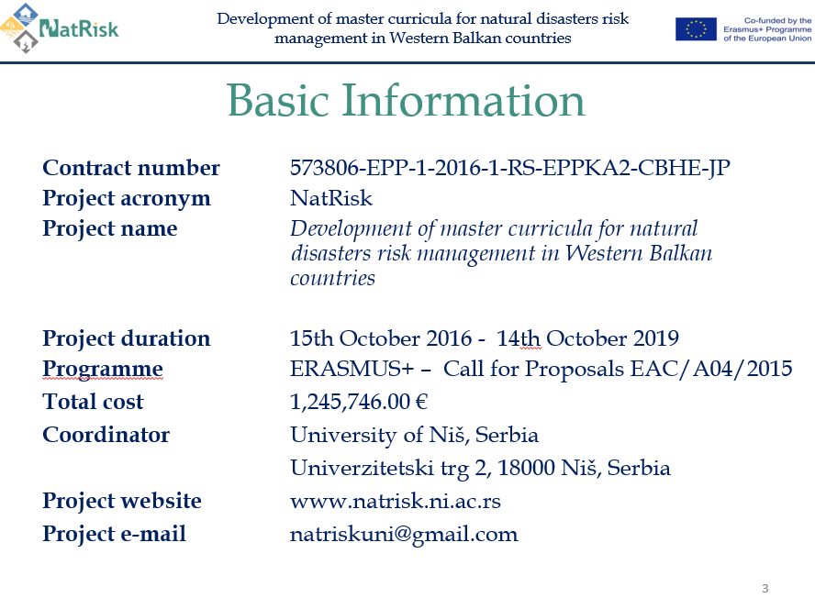
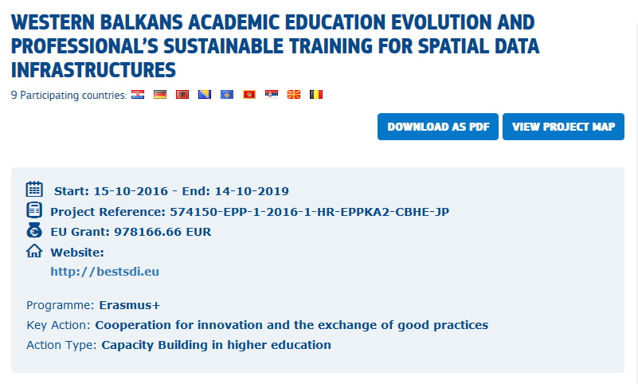
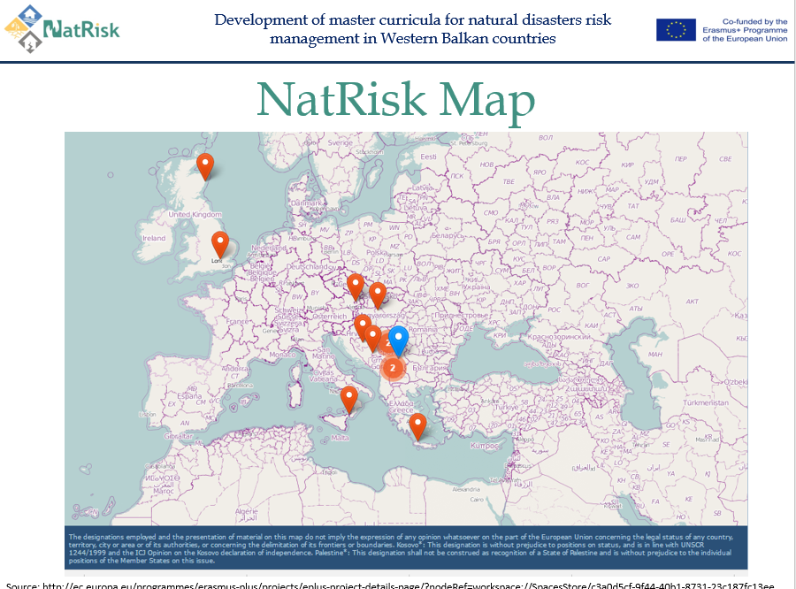
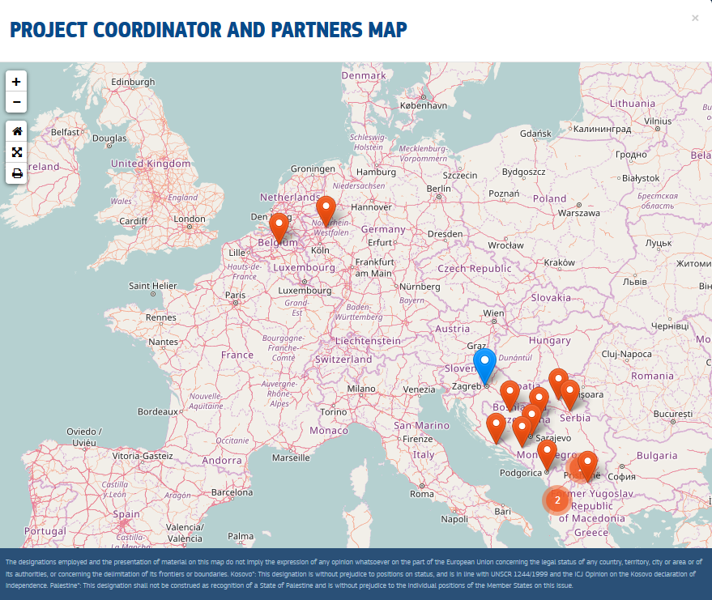
Some information about Erasmus+ NatRisk project and BESTSDI

Slide 4
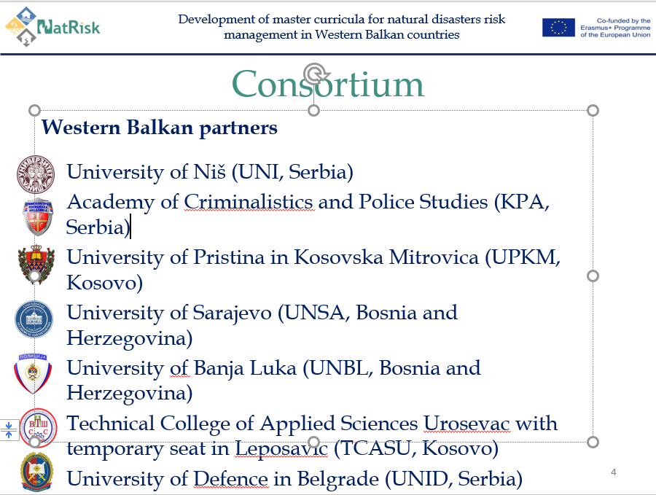
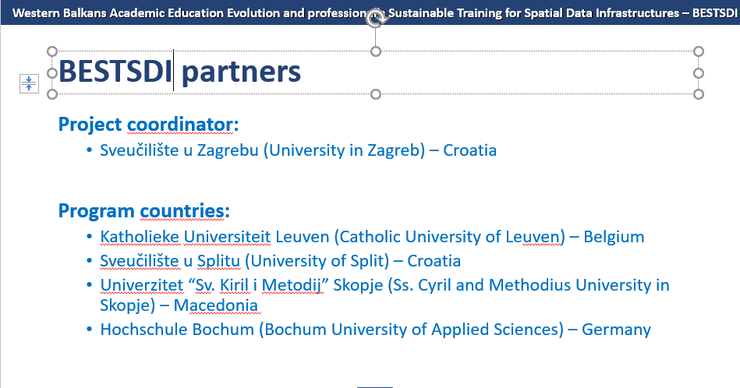
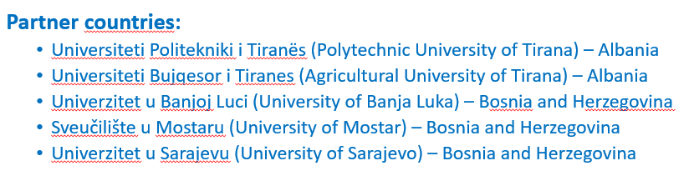
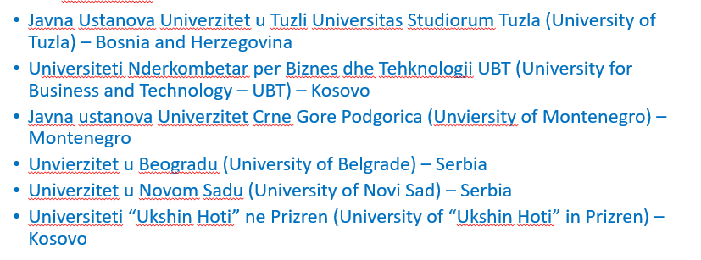
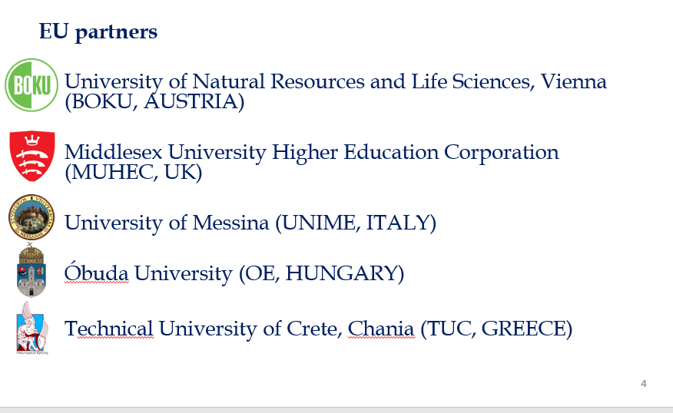
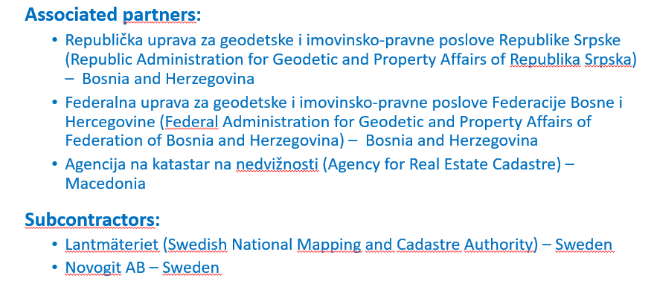


Associated partner:
Republic Hydrometeorological Service of Serbia
Project coordinator:
Project coordinator:

Slide 5
Specific Objectives
2. Goals and objectives of NatRisk and BESTSDI project
important for developing a new project idea
Overall Broader Objective of NatRisk Project
Overall Broader Objective of BESTSDI Project
Education of experts for prevention and management of natural disasters in the region of Western Balkan (WB) according to the national and EU policies.
The wider objectives of the BESTSDI project is to improve the quality of higher education in Geographical Science and Technology field, SDI and geodesy
Specific Objectives
Development and implementation of the new advanced master curricula in Natural Disasters Risk Management (NDRM) in line with the Bologna requirements and national accreditation standards
Development of trainings for the public sector and citizens for reaction in case of various natural disasters
To develop, test and adapt new curricula, courses, learning material and tools within the field of SDI.
In doing so, improve, existing undergraduate and graduate geodesy and geoinformatics curricula’s in the academic institutions in the WB region will be lifter to higher levels, recognising the of spatial data for modern society and its development.

Slide 6
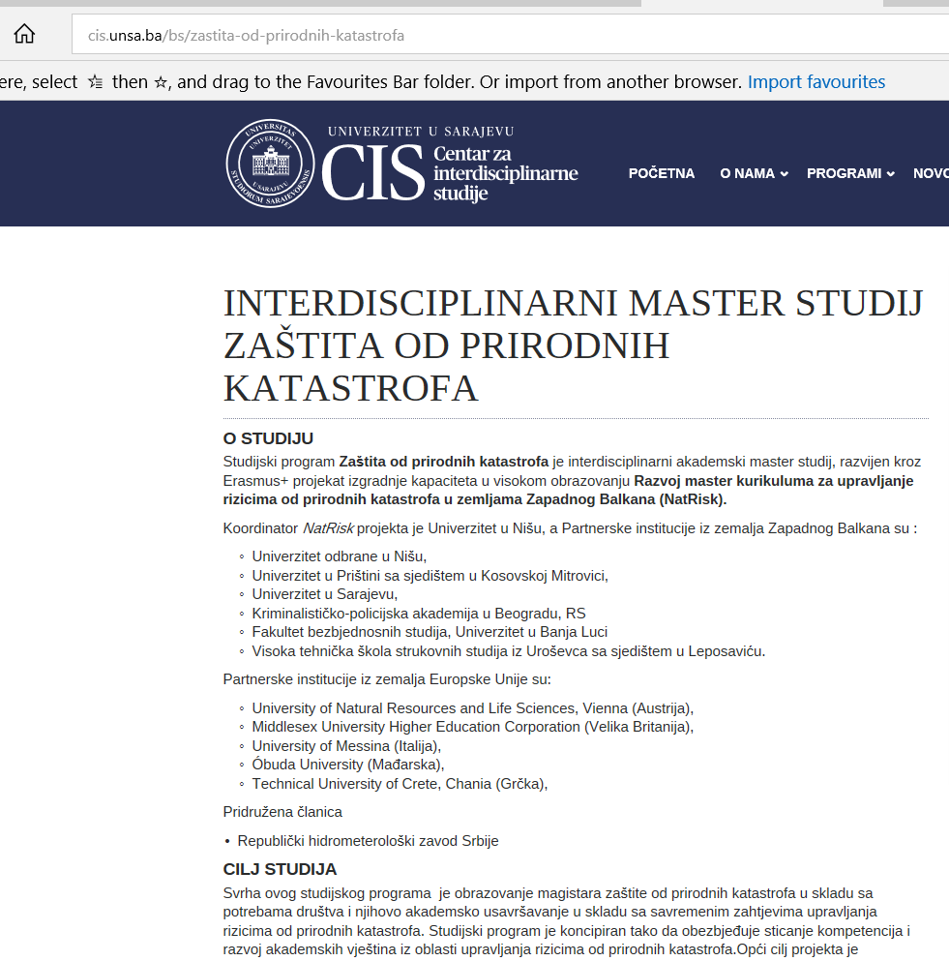
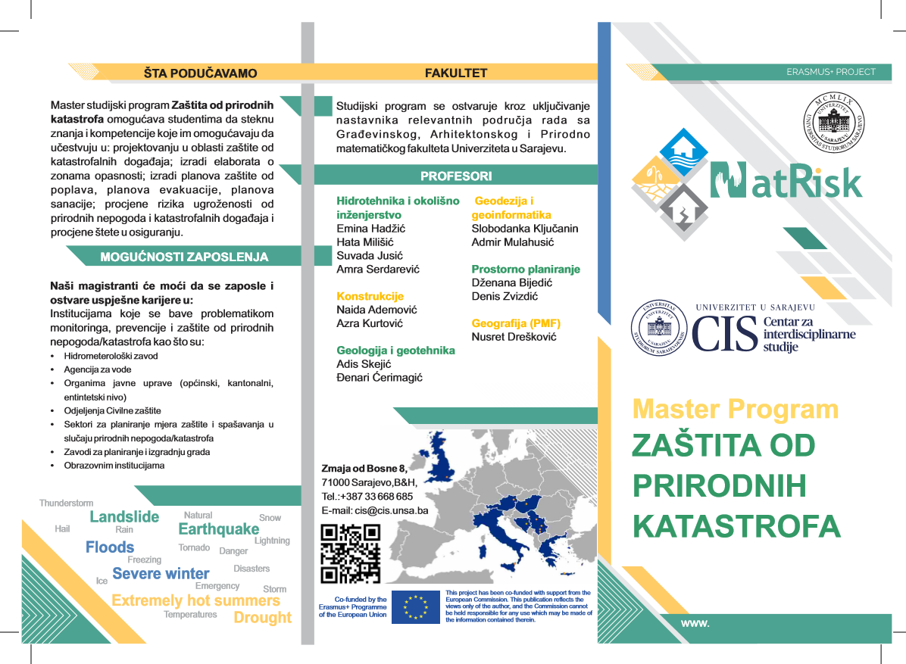
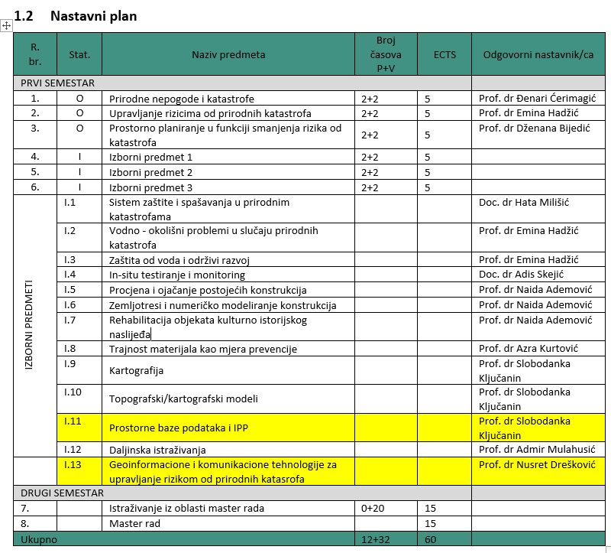
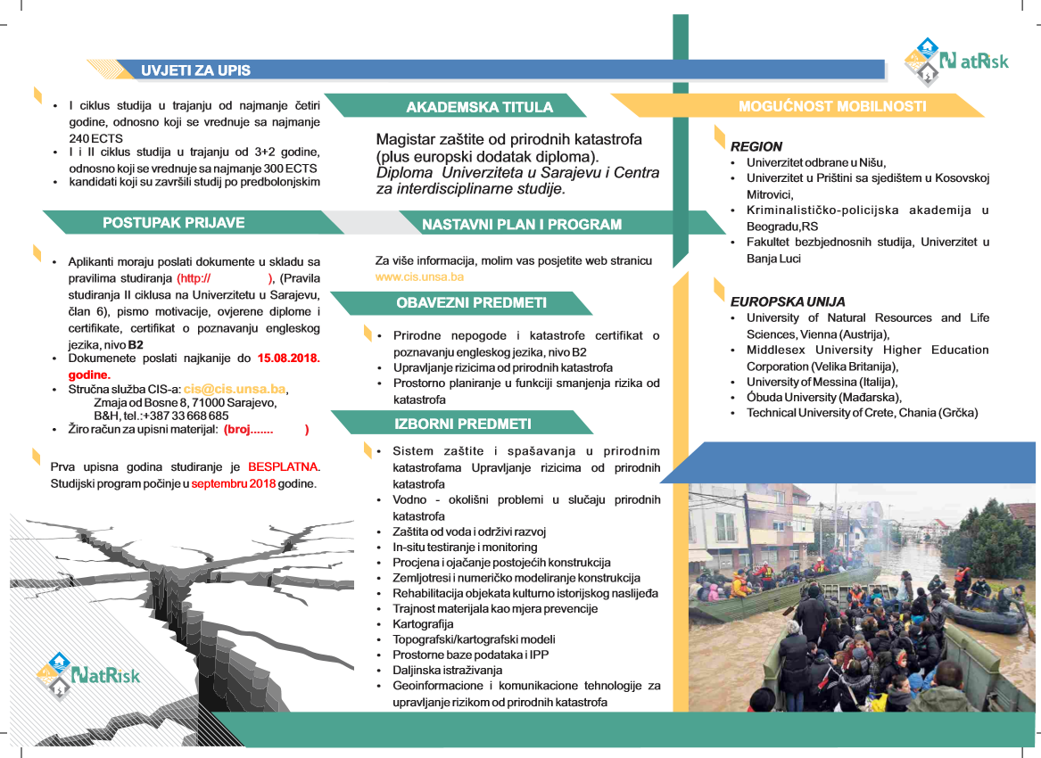
3. Inclusion of GIS and SDI into the curriculum of the new NatRisk master course -
Protection from Natural Disasters
Curriculum
NatRisk has launched 6 new master programs in WB countries
Recognized the importance of SDI and INSPIRE - increasing mitigation ability of the society regarding natural disasters
Conection from NatRisk - BESTSDI:
Spatial databases and SDI
Geoinformation and communication technologies for risk management for natural catastrophes
Importance of EDUCATIN !!!!!!

Slide 7
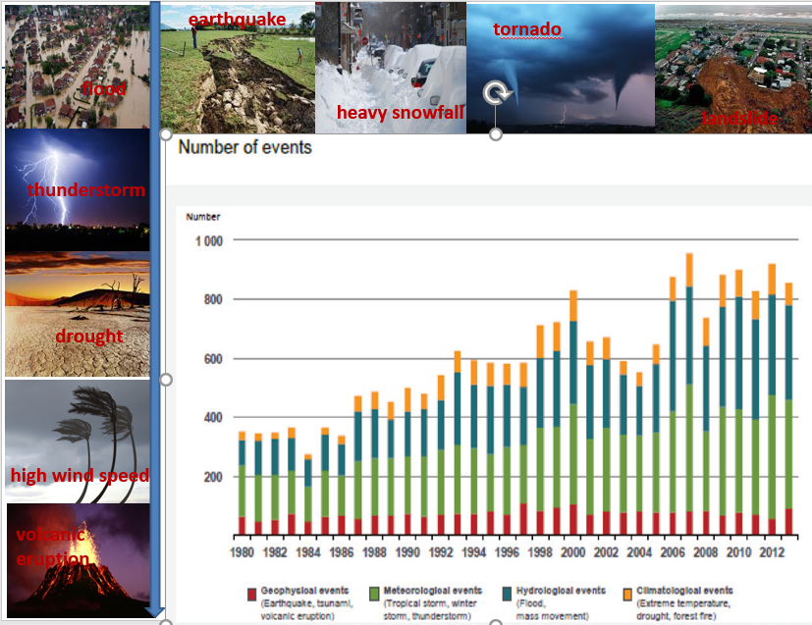
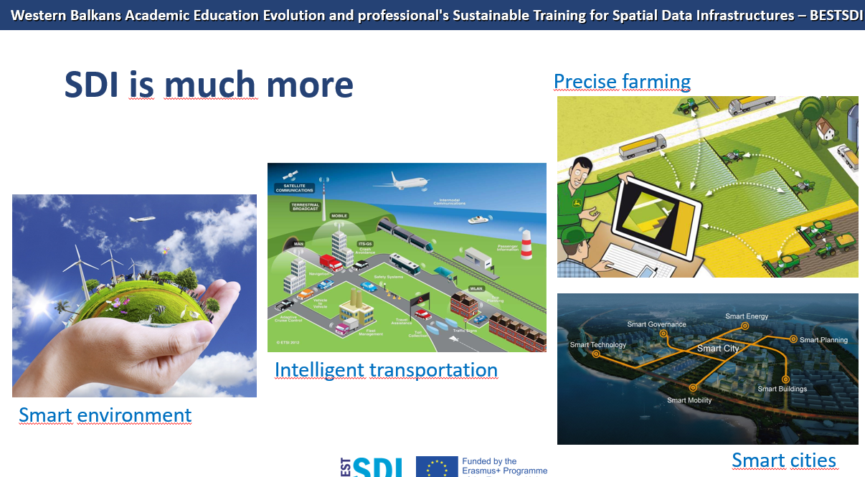
It is difficult and inefficient to talk about managing natural disaster risks without GIS and SDI
We cannot avoid natural hazards, but we can prevent them from becoming disasters.

Slide 8
MOGISMA- Modernization, standardization and innovation of GIS courses for risk and process management in the Western Balkans HEIs teaching process
4. MOGISMA- a new project idea
From NatRiska and BESTSDI
till a new Erasmus + projeci idea
MOGISMA
Wider Objective:
The main aim of the MOGISMA project is to develop modern, innovative and standardized GIS curriculum for study programs educating professions for risk , agriculture and industry management in Western Balkans region with emphasis on the following aspects:
  Conducting comprehensive business requirement analysis and, analysis of present GIS education in EU and Western Balkans region in selected study program profiles.
  Developing innovative teaching/learning curricula and methodologies for risk, agriculture and industry management courses.
  Implementing developed GIS curricula at partner universities
  Establishment/upgrade of business-academia GIS cooperation and developed curricula dissemination/exploitation platforms.

Slide 9
MOGISMA - Specific Project Objective/s:
Establish interactive training program for teachers following the findings of conducted analysis.
Develop, implement and pilot number of improved study courses.
Purchase and installation of GIS equipment at each partner HEI.
Develop new forms and models of LLL courses for academia and business required. Conduct number of such courses in partner countries.
Set up business-academia cooperation/coordination structures to share best practice.
Embed a culture of quality to the project, its outputs and outcomes.

Slide 10
MOGISMA partners
still developing....
Agronomical University Tirana | Faculty of Forestry Sciences
International Burch University
Polytechnical University Tirana | Faculty of Geology and Mine
University of Tuzla | Faculty of Mine, Geology and Civil Engineering
University of Applied Sciences Bochum
University of Bihać | Technical Faculty
University of Montenegro | Biotechnical Faculty
University of Niš | Faculty of Civil Engineering and Architecture
University of Messina
University of Priština in Kosovska Mitrovica | Technical Faculty
University of Sarajevo | Centre for Interdisciplinary Studies Faculty of Agronomy and Food Sciences Faculty of Criminalistics, Criminology and Safety Sciences
University of Ukshin Hoti in Prizren | Faculty of Computer Sciences
University of Zagreb | Faculty of Geodesy Faculty of Geotechnical Engineering

Slide 11
Thank you for your attention!
University of Sarajevo
Obala Kulina bana 7/II
71000 Sarajevo

